Slide 1

EVERGREEN
Your Adaptive Healthcare Ally
duo-ble | Chenrui, Niu | Yuan-Yu, Yang
Notes:
Our product EverGreen is a Healthcare Companion Robot that designed to revolutionize the way we approach well-being.

Slide 2

Vision
“
Integrating innovative technology into daily life to empower individuals to lead healthier and more fulfilling lives.
”
Notes:
Our vision is a world where innovative technology integrates into daily life, empowering individuals to lead healthier and more fulfilling lives.
The EverGreen Healthcare Companion Robot is a revolutionary product designed to provide care and companionship to individuals who require assistance and health monitoring in their daily lives. This versatile and user-friendly robot offers a range of features to enhance the well-being and independence of its users.

Slide 3

Goal
Provide a versatile solution to address the unique challenges faced by
individuals requiring support in their daily lives.
Such as medication management, mobility assistance, vital signs monitoring, companionship, and an emergency notification system.
Notes:
In response to the diverse challenges in healthcare, our goal is to

Slide 4

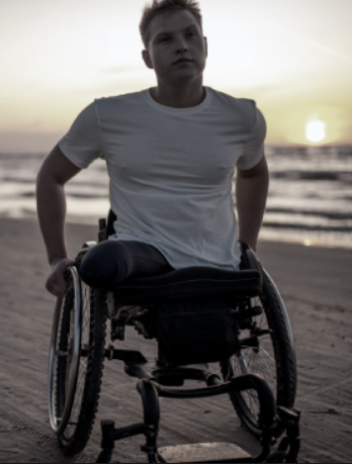
Persona 1 & User Stories
Mr. Jeremy Jack, Snyder
• Job Title: Student
• Age: 21 years old
• Ethnicity: American
• Goals and Tasks:
Recovery Support: Assist Jeremy in his physical therapy exercises and routines.
Social Interaction: Engaging in meaningful conversations, providing emotional support, and combating feelings of isolation.

Slide 5
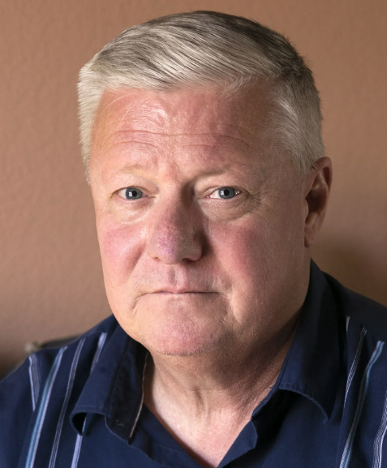
Persona 1 & User Stories
Mr. Michael James, Anderson
• Job Title: Former FBI
• Age: 76 years old
• Ethnicity: American
• Goals and Tasks:
To help him with his joint Rehabilitation.
To assist him, make an appointment to his family doctor and let the doctor come to his home.
Chatting and talking with him.

Slide 6
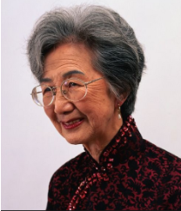
Persona 2 & User Stories
Ms. Wei, Li
• Job Title: Housewife
• Age: 86 years old
• Ethnicity: Asia American
• Goals and Tasks:
Chatting and talking with her in Chinese.
Keeping her company
Record her blood pressure, heart rate and pulse.
Remind her to take her high blood pressure medication.

Slide 7
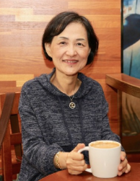
Persona 2 & User Stories
Ms. Elizabeth Grace, Williams
• Job Title: A former elementary school teacher.
• Age: Elderly persons aged 65
• Ethnicity: Not distinguishing between different races.
• Goals and Tasks:
Taking care of her (assisting with bathing, dressing, and toileting).
Reminding her to take her medication

Slide 8

Key Features
Medication Management
Assistance with Mobility
Vital Signs Monitoring
Companionship and Entertainment
Emergency Notification System
Notes:
Let's delve into the key features of our companion robot.
1. Medication Management: The EverGreen robot reminds users to take their medications at the prescribed times, dispenses the correct doses, and maintains a medication schedule. This feature ensures that users adhere to their treatment plans, promoting better health outcomes.
2. Assistance with Mobility: EverGreen can help patients with tasks like dressing, bathing, and toileting, particularly useful for individuals with physical disabilities or limited mobility.
3. Vital Signs Monitoring: EverGreen is equipped with sensors to monitor vital signs, including blood pressure, heart rate, and blood glucose levels, and deliver real-time feedback.
4. Companionship and Entertainment: EverGreen serves as a friendly companion. It engages users in conversations, plays games, streams entertainment, and can even read books or news aloud to the user.
5. Emergency Notification System: EverGreen incorporates an automatic emergency notification system. It can alert designated contacts or 911 in case of falls, health crises, or other emergencies.

Slide 9
User Stories /Acceptance Criteria
1. As a professional with busy schedule, I rely on the device to remind me of my medication schedule, dispense the correct doses, and ensure I adhere to my treatment plan for optimal health management.
2. As a person with limited mobility, I appreciate the assistance with tasks like dressing, bathing, and toileting, providing me with the support I need to maintain my daily routine independently.
Notes:
Our Development is User-Centric
Understanding user stories shapes our development process to meet real-life needs.

Slide 10
User Stories /Acceptance Criteria
3. As someone with a chronic health condition, I need a device to monitor my vital signs, including blood pressure and glucose levels, and provide real-time feedback.
4. As an individual living alone, I need a friendly companion, to engage me in conversations, play games, read books or news aloud to help combat loneliness, contributing to my emotional well-being.

Slide 11
User Stories /Acceptance Criteria
5. As a person with a history of health crises, I need a device that has an automatic emergency notification system. In case of a fall or other emergencies, it promptly alerts designated contacts or emergency services.
6. As a family member living far away from my elderly parents, I need some device to facilitate remote connection so that I can check on their well-being through the monitoring features, engage in virtual conversations, and ensure they receive timely assistance in case of emergencies.

Slide 12
User Stories /Acceptance Criteria
7. As someone recovering from surgery, I need a robot to assist me in daily tasks like fetching items, ensuring I adhere to post-operative care routines, and providing a sense of companionship during the recovery period.
8. Struggling with anxiety and depression, I need emotional support to engage in mood-boosting activities. It's recommended to incorporate relaxation exercises, contributing to my mental health and overall well-being.

Slide 13
Product Canvas
Vision
Integrating innovative technology into daily life to empower individuals to lead healthier and more fulfilling lives.
Name EverGreen | Goal To provide a versatile solution that addresses the unique challenges faced by individuals requiring support in their daily lives.
Target Group Retired single person who enjoys living alone. Elderly people whose adult children do not live with them. Disabled persons who live by themself but are highly in need of care. People who live in the U.S. but do not speak English and need to be cared for. | Big Picture A smart, family-like companion with professional care functions. With built-in sensors and emergency notifications. Realize the emotional needs of immediate care and companion users. | Product Details Medication Management Assistance with Mobility Vital Signs Monitoring Companionship and Entertainment Emergency Notification System
Metrics (OKR)
Achieve User Adoption
Improve Development Efficiency
Enhance Accessibility
Ensure Product Stability
and Reliability
Ensure Data Security and Privacy

Slide 14
Story Points for each User Story
Score 1
Score 3
Score 2
As a professional with a busy schedule, I rely on the device to remind me of my medication schedule, dispense the correct doses, and ensure I adhere to my treatment plan for optimal health management.
As a person with limited mobility, I would like the assistance with tasks like dressing, bathing, and toileting, providing me with the support I need to maintain my daily routine independently.
As someone with a chronic health condition, I need a device to monitor my vital signs, including blood pressure and glucose levels, and provide real-time feedback.
As a professional with a busy schedule, I rely on the device to remind me of my medication schedule, dispense the correct doses, and ensure I adhere to my treatment plan for optimal health management.
As a person with limited mobility, I would like the assistance with tasks like dressing, bathing, and toileting, providing me with the support I need to maintain my daily routine independently.
As someone with a chronic health condition, I need a device to monitor my vital signs, including blood pressure and glucose levels, and provide real-time feedback.
As an individual living alone, I need a friendly companion, to engage me in conversations, play games, read books or news aloud to help combat loneliness, contributing to my emotional well-being.
As a person with a history of health crises, I need a device that has an automatic emergency notification system. In case of a fall or other emergencies, it promptly alerts designated contacts or emergency services.
As a family member living far away from my elderly parents, I need some device to facilitate remote connection so that I can check on their well-being through the monitoring features, engage in virtual conversations, and ensure they receive timely assistance in case of emergencies.
As someone recovering from surgery, I need a robot to assist me in daily tasks like fetching items, ensuring I adhere to post-operative care routines, and providing a sense of companionship during the recovery period.
Struggling with anxiety and depression, I rely on the robot for daily emotional support. It engages in mood-boosting activities, and recommends relaxation exercises, contributing to my mental health and overall well-being.
Notes:
Measur Development Complexity by Assigning story points to ensure efficient development.
These points guide our Agile development process, reflecting complexity and effort.

Slide 15
Story Points for each User Story
Score 5
Score 3
Score 5
As someone recovering from surgery, I need a robot to assist me in daily tasks like fetching items, ensuring I adhere to post-operative care routines, and providing a sense of companionship during the recovery period.
Struggling with anxiety and depression, I need daily emotional support to engage in mood-boosting activities. It's recommended incorporate relaxation exercises, contributing to my mental health and overall well-being.
As an individual living alone, I need a friendly companion, to engage me in conversations, play games, read books or news aloud to help combat loneliness, contributing to my emotional well-being.

Slide 16
Story Points for each User Story
Score 4
Score 3
As a family member living far away from my elderly parents, I need some device to facilitate remote connection so that I can check on their well-being through the monitoring features, engage in virtual conversations, and ensure they receive timely assistance in case of emergencies.
As a person with a history of health crises, I need a device that has an automatic emergency notification system. In case of a fall or other emergencies, it promptly alerts designated contacts or emergency services.

Slide 17
Roadmap
Now (Release 1.0 - Essentials): Medication, Monitoring Vital Signs
In Version 1.0 we will focus on our robot basic functionality.
Focusing on detecting users’ health conditions..
Next (Release 2.0 - Enhanced): Mobility Assistance, Emergency Notification
After the initial testing phase has concluded and valuable user feedback has been gathered, the next step involves enhancing Version 2.0.
This phase will focus on development of mobility features for robots.
Aim to improve the overall functionality and versatility of the robotic system, ensuring it meets the evolving needs and expectations of users.
Adjust the robot from our users' questionnaires. We will also enhance the Emergency Notification system.
Later (Release 3.0 - Advanced): Support for Caregivers, Adaptive Assistance, Companionship
In the final version, we will focus on the emotional needs of our users to fulfill their mental companionship.
Let users have a strong sense of belonging by creating companionship algorithms

Slide 18
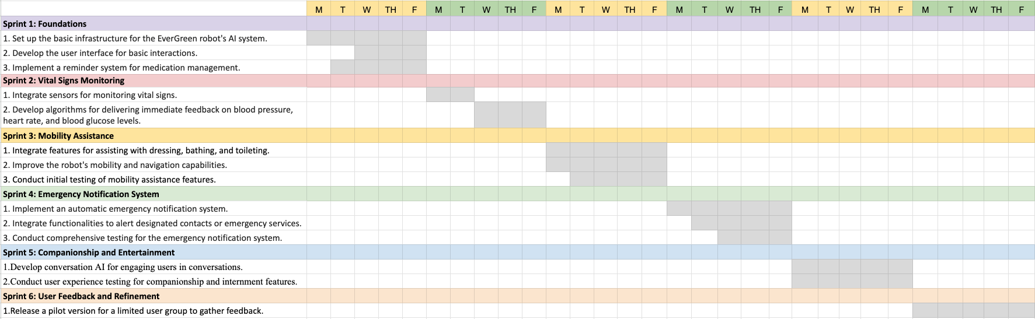
Sprint Plan
Sprint 2:
Vital Signs
Monitoring
Sprint 3:
Mobility
Assistance
Sprint 1:
Foundations
Sprint 4:
Emergency
Notification System
Sprint 6:
User Feedback
& Refinement

Slide 19
Metrics/5 OKRs
Improve Product Development Efficiency
KR: Increase the number of successful sprints by 20%, as measured by the completion of planned user stories and features.
Achieve User Adoption
KR: Attain at least a 10% adoption rate among the target demographic within one year of product launch.
Enhance Accessibility
KR: Implement features addressing specific accessibility requirements, as identified through user feedback and testing.
Notes:
These OKRs ensure a holistic measure of our success.

Slide 20
Metrics/5 OKRs
Ensure Product Stability and Reliability
KR: Achieve a 99.5% system uptime, minimizing downtime and service interruptions for end-users.
KR: Decrease the average response time for critical bug fixes to less than 24 hours, addressing issues promptly.
Ensure Data Security and Privacy
KR: Achieve 100% compliance with industry-standard data protection regulations through regular audits and updates to privacy policies.

Slide 21
Important User Testing
Conduct initial testing of mobility assistance features.
Creating algorithms for quick feedback on blood pressure, heart rate, and blood glucose levels.
Develop conversational AI for engaging users in conversations.
Integrate functionalities to alert designated contacts or emergency services.

Slide 22
User Testing
EVERGREEN
Product: EVERGREEN
Hypothesis: Let's assume that a user will incorporate our Vital Signs Monitoring feature as an integral part of their daily life.
Prototype: EVERGREEN_Version 1
Value Questions:
Do you believe that the automatic blood pressure monitoring feature will streamline the process of tracking your health daily, saving you valuable time?
Do you place greater reliance on automatic blood pressure monitoring as opposed to traditional blood pressure monitors?
Wouldn't an automated body monitoring device offer you enhanced peace of mind when it comes to diligently monitoring your health?
Do you consider the capability of our robots to measure your blood pressure, heart rate, and blood glucose levels promptly, providing real-time feedback, as a crucial and necessary feature for your health monitoring needs?
Your Adaptive Healthcare Ally

Slide 23
User Testing
EVERGREEN
Product: EVERGREEN
Hypothesis: Let's assume that users will incorporate our Emergency Notification System feature as an integral part of their daily lives.
Prototype: EVERGREEN_Version 1
Value Questions:
Do you believe that the Emergency Notification System feature will provide you with added peace of mind, especially when living alone?
Do you anticipate that the Emergency Notification System feature will enable your family to promptly receive information about your health in case of an emergency?
Is an automated Emergency Notification System one of the key features you prioritize when considering health monitoring options?
Regarding the Emergency Notification System, do you prefer it to send notifications directly from the robot, or would you rather have the option to send notifications manually to your friends and family?
Your Adaptive Healthcare Ally

Slide 24
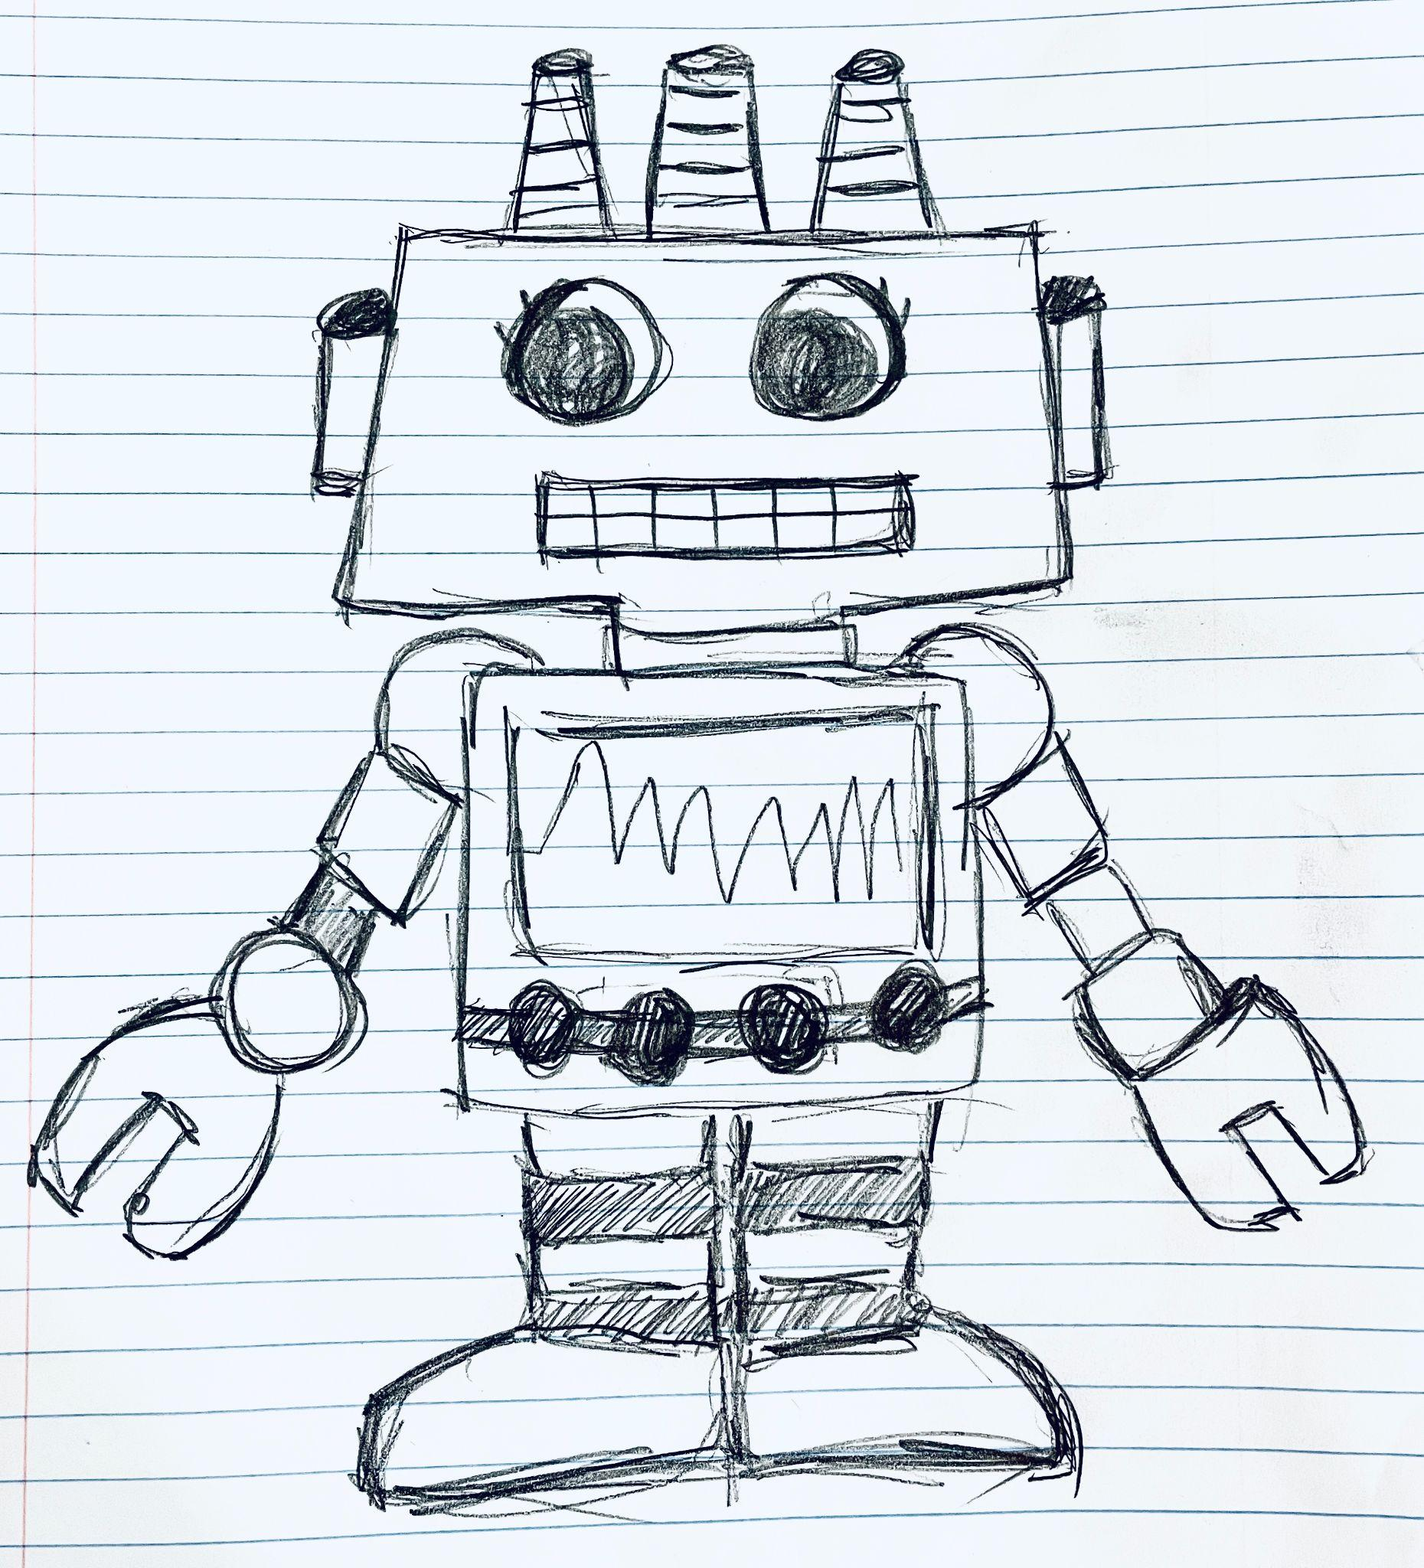
Prototype 1
Robot Alice
Able to walk
With a wifi function, it can notify the user's family when an emergency occurs.
Keyboard input function
Heartbeat dashboard

Slide 25

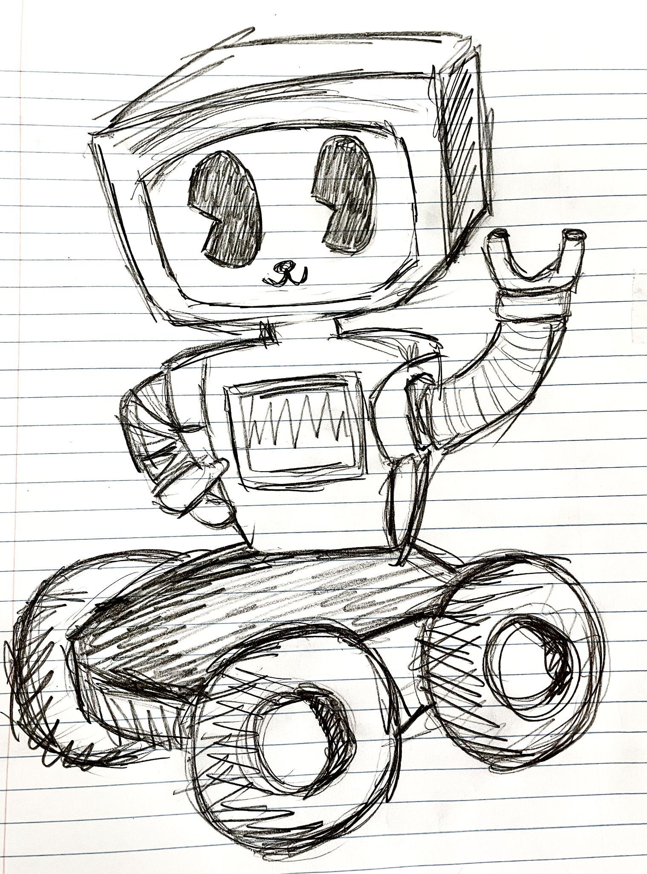
Prototype 2
Robot Jack
Highly stable when in walking
There's a storage area in the front where users can put their stuff to do house work.
Voice input function
Heartbeat dashboard

Slide 26

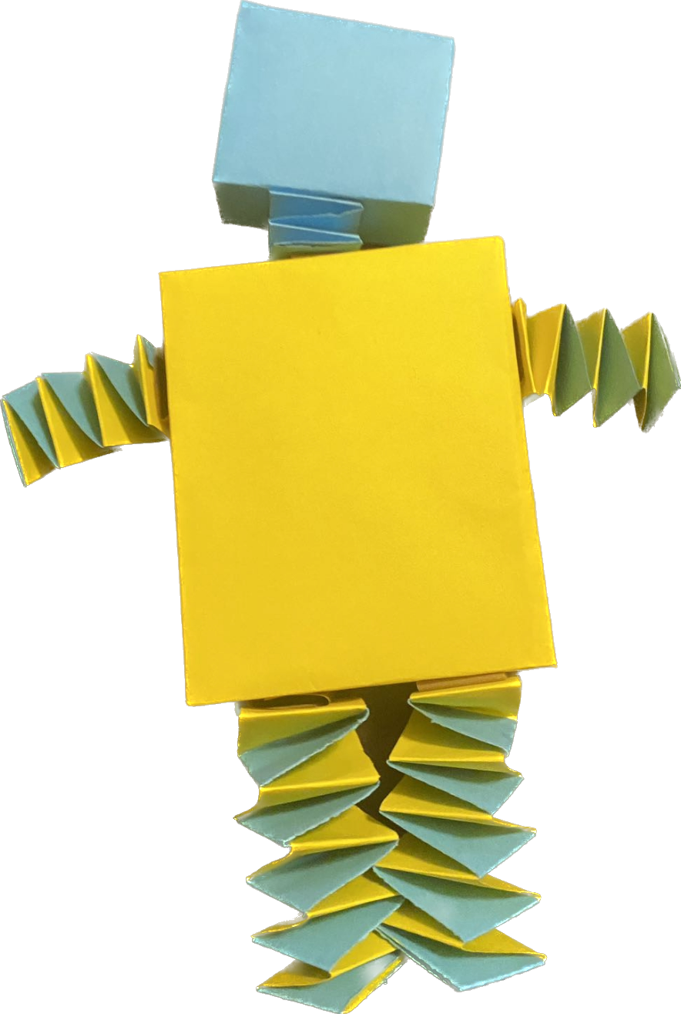
Prototype 3
Robot Luka
Allow user to personalize commands.
Detects and responds to user emotions.
Identifies falls and triggers emergency alerts

Slide 27

Prototype 3
Robot Luna
Allow control through gestures.
Can play board games with users.
With longer and more flexible arms that allow it to reach objects further away.

Slide 28
Thank you
for
your listening!
EVERGREEN
Your Adaptive Healthcare Ally

